Slide 1
Parking Guidance System Solution

Slide 2
About Us
Mr.Nguyễn Đức Lợi
Supervisor
Trần Nguyễn Minh Trung
Firmware: System architecture & interface protocol
Software: Android Application
Bùi Phú Hiệp
Nguyễn Đỗ Phương Huy
Hardware: Design & Implement
Software: Web Server
Hardware: Implement
Testing: Design and Execute

Slide 3
Outline
Problem
Solution
How the System Works
Web Service
Hardware
Firmware & Software Implement
Advantages & Disadvantages
Future Plan
Demo

Slide 4
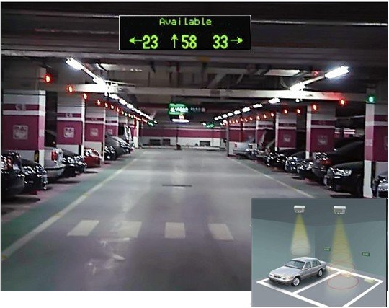
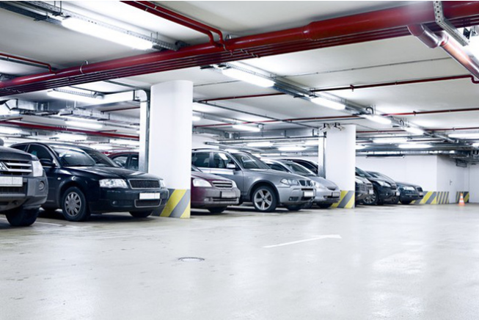
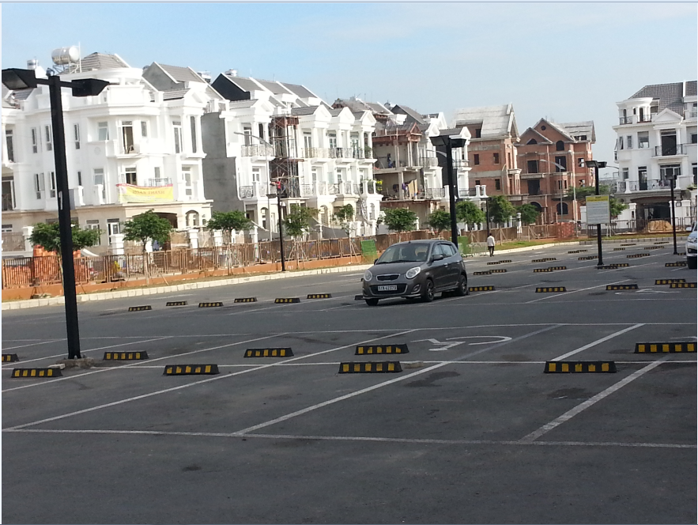
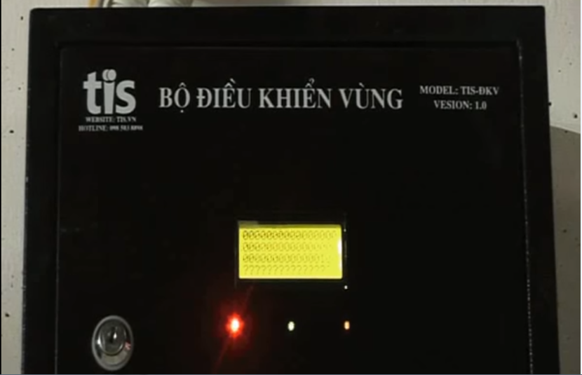
Problem

Slide 5
Problem
Limited number of monitored parking lots
Complicated planning of wired system
Incompatible with outdoor system
Limited information provided to drivers

Slide 6
Solution

Slide 7

How the system works

Slide 8

How the system works

Slide 9

How the system works

Slide 10

How the system works

Slide 11
How the system works
Collect Data

Slide 12
How the system works
Update Information

Slide 13

How the system works
Send data

Slide 14
How the system works
Receive command

Slide 15
How the system works
Update Status

Slide 16
How the system works

Slide 17
How the system works
Collect Data

Slide 18

How the system works
Get Information

Slide 19
How the system works
Issue a command

Slide 20
How the system works
Send Command

Slide 21
How the system works

Slide 22


Web Service
Database
Web server

Slide 23
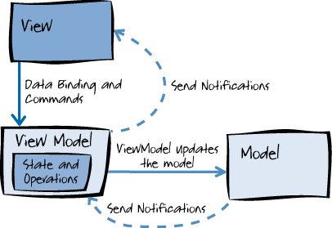
Web Service

Slide 24
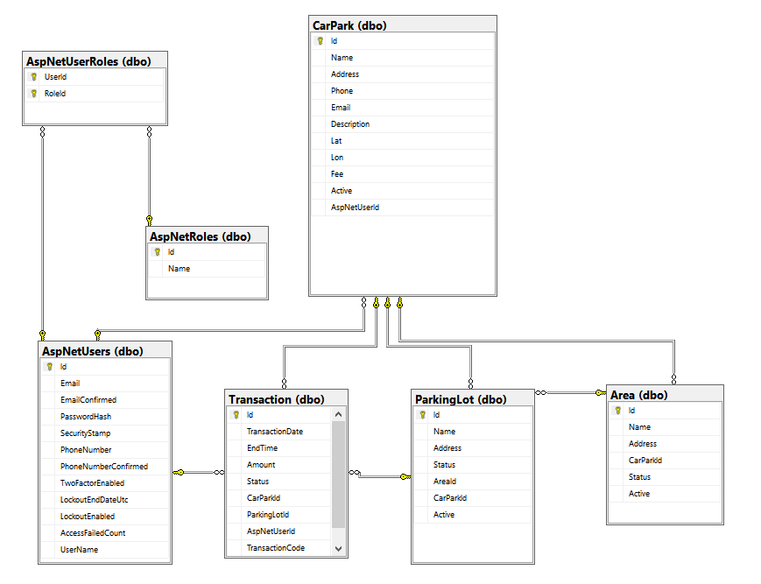
Web Service

Slide 25
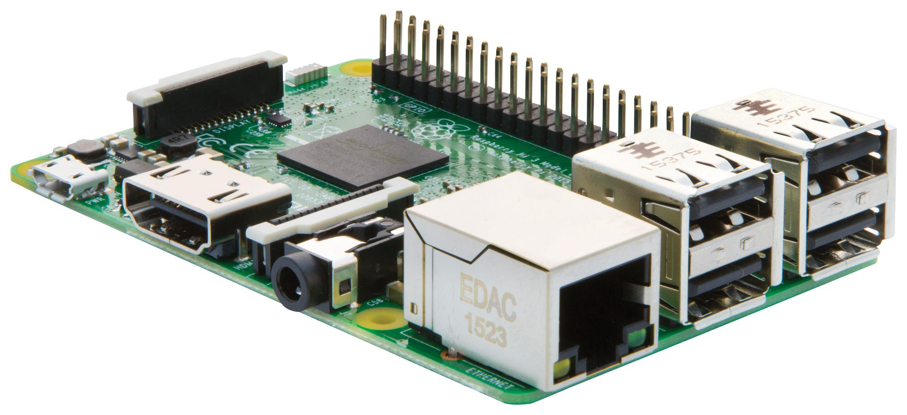
Hardware

Slide 26
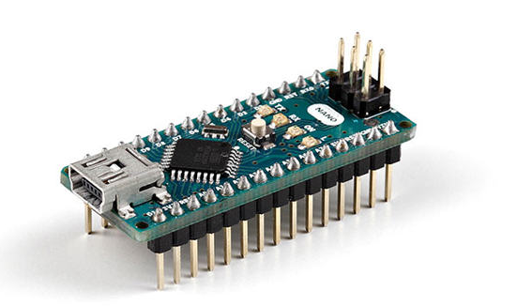
Hardware

Slide 27
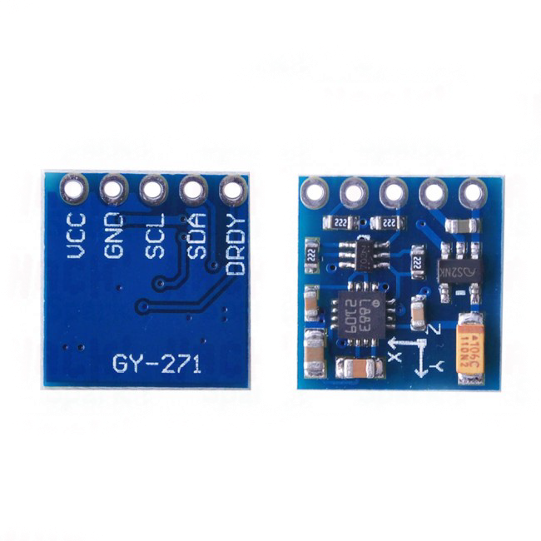
Hardware

Slide 28
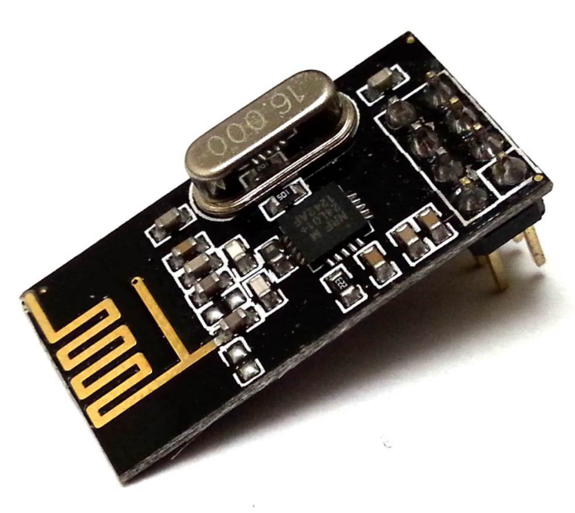
Hardware

Slide 29
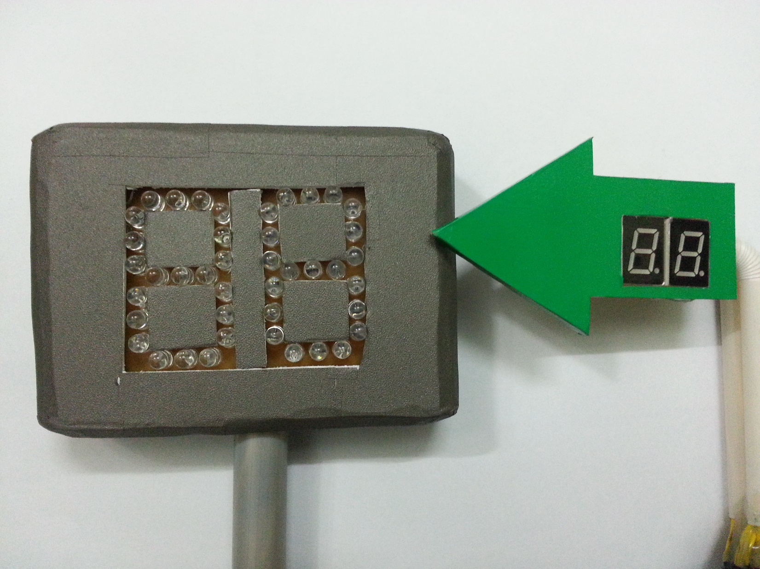
Hardware

Slide 30
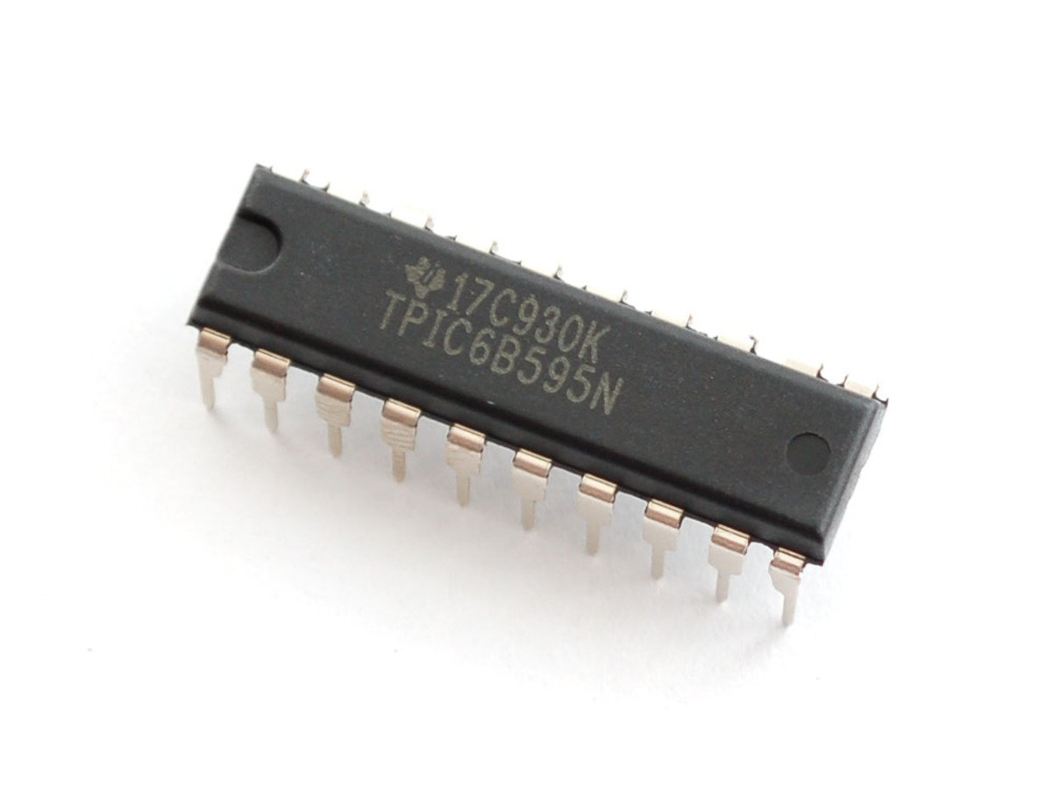
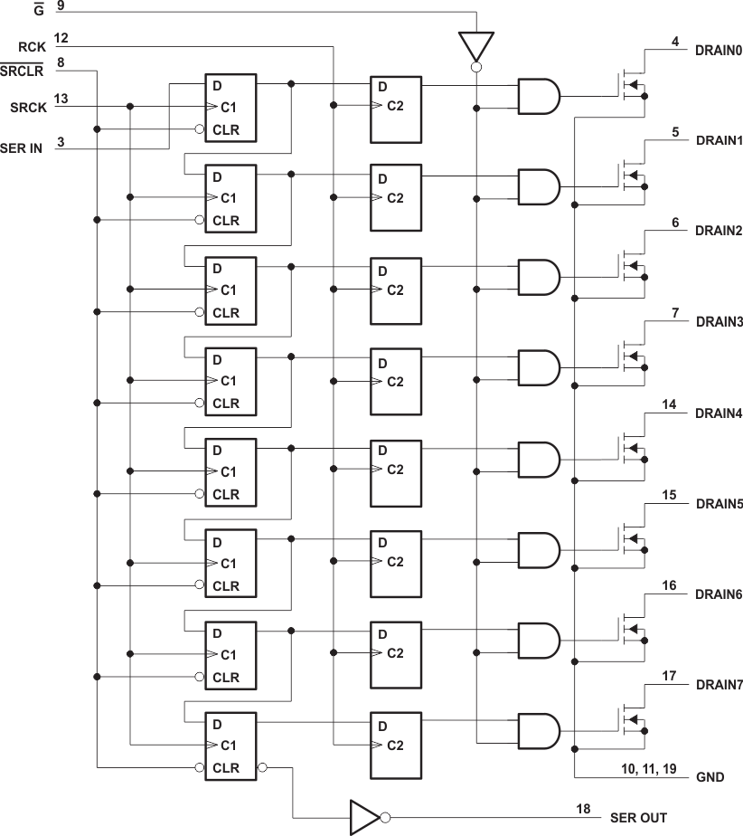
Hardware

Slide 31

Hardware

Slide 32
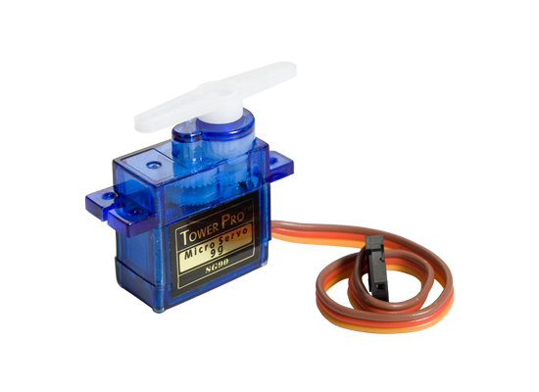
Hardware

Slide 33
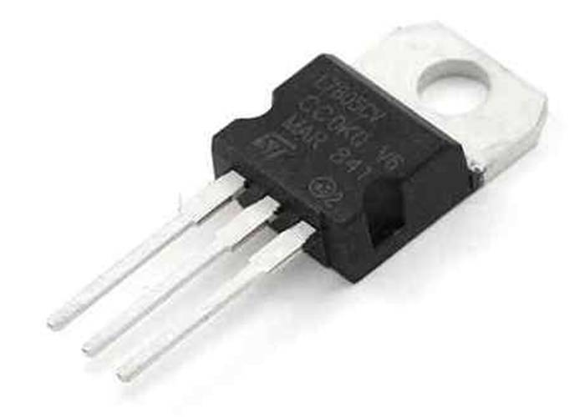
Hardware

